Slide 1
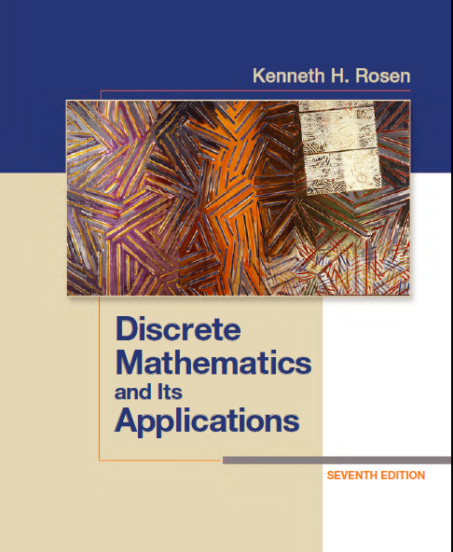
Discrete Math (2)
Haiming Chen
Associate Professor, PhD
Department of Computer Science,
Ningbo University
http://www.chenhaiming.cn

Slide 2
Content
Part I
Logic and Proofs
Boolean Algebra
Part II
Sets, Functions, Sequences, and Matrices
Relations
Trees
Graphs
Algorithms
Induction and Recursion
Modeling Computation
Part III
Number Theory
Discrete Probability
Counting
Advanced Counting Techniques
Data Structure & Algorithm

Slide 3
Review
Logic and Proofs
Propositional Logic
Predicates and Quantifiers
Proofs and Proof Methods
Sets, Functions, Sequences, Sums, and Matrices
Number Theory and Cryptography
Translating from English into Logical Expressions

Slide 4
Logic Expression
You can access the Internet from campus only if you are a computer science major or you are not a freshman
Express the statements “Some student in this class has visited Mexico” and “Every student in this class has visited either Canada or Mexico” using predicates and quantifiers.

Slide 5
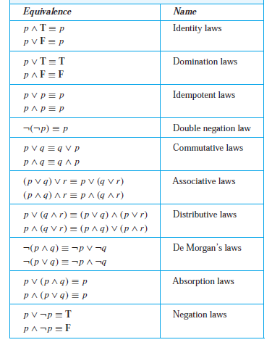
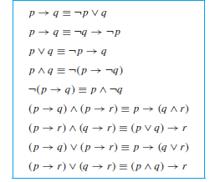
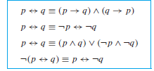
Logic Equivalences

Slide 6
Logic and Bit Operations_{P11}
A bit can be used to represent a truth value, because there are two truth values, namely, true and false.
1 represents T (true), 0 represents F (false).
A variable is called a Boolean variable if its value is either true or false.

Slide 7
Boolean Algebra
Chapter 12
Boolean Operators
Complement
Boolean sum
Boolean product
Precedence for boolean operators
Complement > Boolean product > sum

Slide 8
Example

Slide 9
Boolean Function
Represented using expressions made up from variables and Boolean operations.
Every Boolean function can be represented by a Boolean expression

Slide 10
Boolean Function
Complement of the Boolean function F
Boolean sum F + G
Boolean product FG

Slide 11
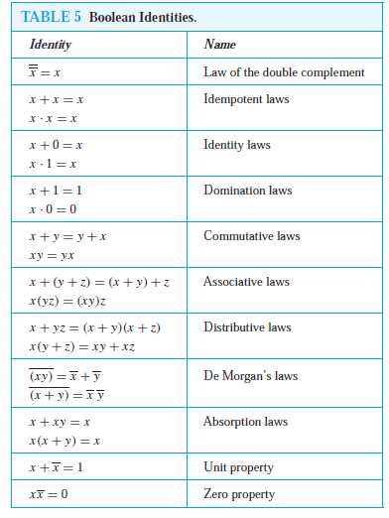
Identities of Boolean Algebra

Slide 12
Duality
The dual of a Boolean expression is obtained by interchanging Boolean sums and Boolean products and interchanging 0s and 1s.

Slide 13
Duality principle
An identity between functions represented by Boolean expressions remains valid when the duals of both sides of the identity are taken

Slide 14
Example

Slide 15
Homework
Page 818, Exercise 5, 25, 28

