Slide 1
Discrete Math (2)
Haiming Chen
Associate Professor, PhD
Department of Computer Science,
Ningbo University
http://www.chenhaiming.cn

Slide 2
Partial Orderings
A relation R on a set S is called a partial ordering or partial order if it is reflexive, antisymmetric, and transitive.
A set S together with a partial ordering R is called a partially ordered set, or poset, and is denoted by (S,R).

Slide 3
Example 1
“greater than or equal” relation (≥) on the set of integers
reflexive?
antisymmetric?
transitive?

Slide 4
Example 2
The divisibility relation | on the set of positive integers
reflexive?
antisymmetric?
transitive?

Slide 5
Example 3
the inclusion relation ⊆ on the power set of a set S
reflexive?
antisymmetric?
transitive?

Slide 6
Example 4
Let R be the relation on the set of people such that xRy if x and y are people and x is older than y.
antisymmetric?
transitive?
reflexive?

Slide 7
Partial Orderings
In different posets different symbols such as ≤, ⊆, and |, are used for a partial ordering.
a symbol that we can use when we discuss the ordering relation in an arbitrary poset
the symbol is used to denote the relation in any poset, not just the “less than or equals”relation

Slide 8
Partial Orderings
When every two elements in the set are comparable, the relation is called a total ordering.
A totally ordered set is also called a chain.

Slide 9
Lexicographic Order
two posets,
lexicographic ordering on A₁ × A₂

Slide 10
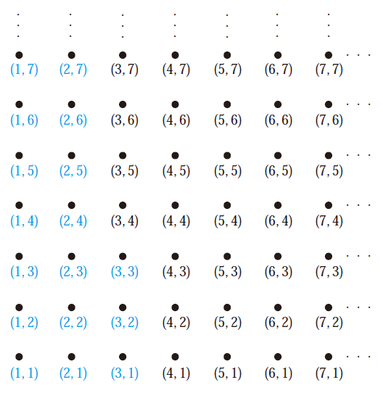
Example 1

Slide 11
Lexicographic Order
A lexicographic ordering can be defined on the Cartesian product of n posets

Slide 12
Lexicographic Order
The definition of lexicographic ordering is that the string a₁a₂ . . . a_{m} is less than b₁b₂ . . . b_{n} if and only if
t = min(m, n)

Slide 13
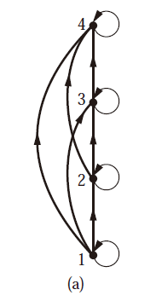
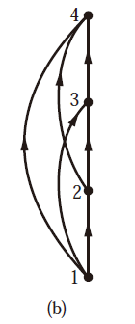
Hasse Diagrams
all edges are pointed “upward”
a partial ordering must be reflexive
a partial ordering must be transitive

Slide 14
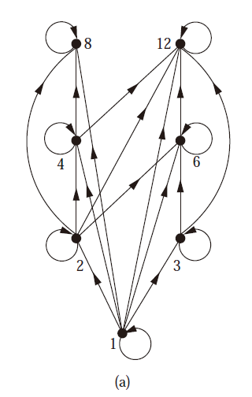
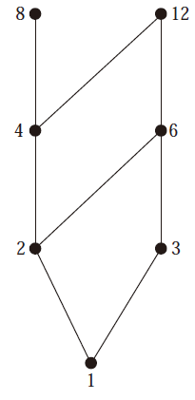
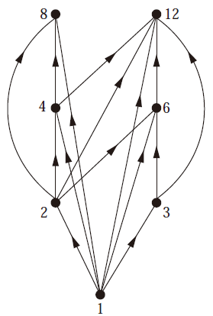
Example 1
Draw the Hasse diagram representing the partial ordering {(a, b) |a divides b} on {1, 2, 3, 4, 6, 8, 12}.

Slide 15
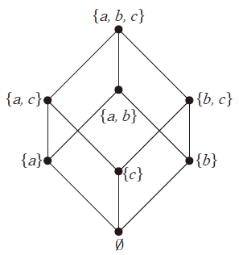
Example 2
Draw the Hasse diagram for the partial ordering {(A,B) | A ⊆ B} on the power set P(S) where S = {a, b, c}.
{a,b,c}
{a,c}
{b,c}
{a,b}
{a}
{c}
{b}
∅

Slide 16
Maximal and Minimal Elements
a is maximal in the poset (S, ) if there is no b ∈ S such that a ≺ b.
a is minimal if there is no element b ∈ S such that b ≺ a.
They are the “top” and “bottom” elements in the diagram.

Slide 17
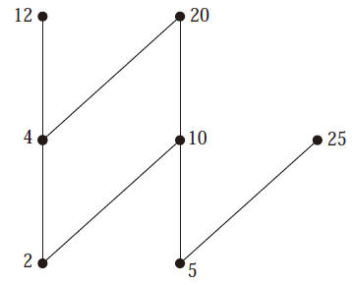
Maximal and Minimal Elements
Which elements of the poset ({2, 4, 5, 10, 12, 20, 25}, |) are maximal, and which are minimal?
greatest element
greatest element
least element
least element

Slide 18
Upper bound and lower bound
an element that is greater than or equal to all the elements in a subset A of a poset (S, ).
u is an element of S such that a u for all elements a ∈ A
l is an element of S such that l a for all elements a ∈ A

Slide 19
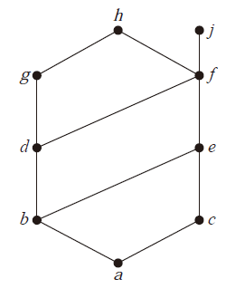
Example 1
Find the lower and upper bounds of the subsets {a, b, c}, {j, h}, and {a, c, d, f }
e, f, j, and h ; a
; a, b, c, d, e, and f
f , h, and j; a
least upper bound
greatest lower bound

Slide 20
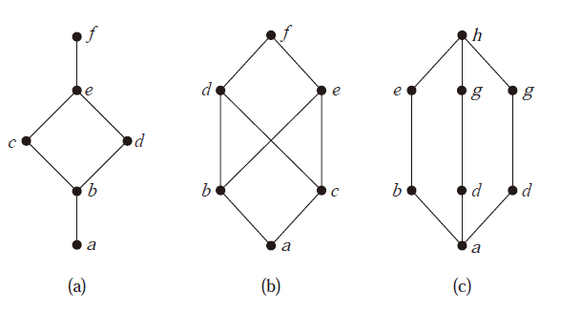
Lattices
A partially ordered set in which every pair of elements has both a least upper bound and a greatest lower bound

Slide 21
Homework
Page 630, Ex.8(c), 21, 32, 43(a)

