Slide 1
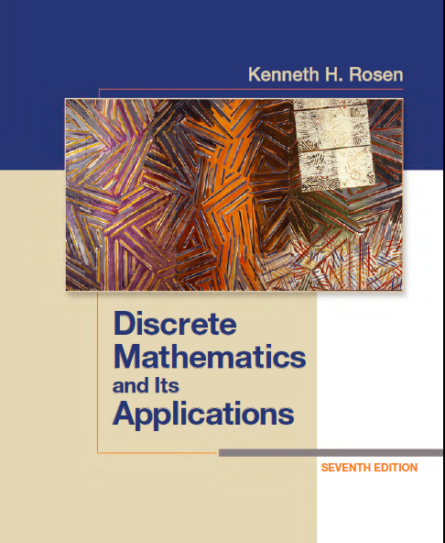
Discrete Math (2)
Haiming Chen
Associate Professor, PhD
Department of Computer Science,
Ningbo University
http://www.chenhaiming.cn

Slide 2
Content
Part I
Logic and proofs
Boolean Algebra
Part II
Sets, Functions, Sequences, and Matrices
Relations
Trees
Graphs
Algorithms
Induction and Recursion
Modeling Computation
Part III
Number Theory
Discrete Probability
Counting
Advanced Counting Techniques
Data Structure & Algorithm

Slide 3
Sequences
A sequence is a function from a subset of the set of integers (usually either the set {0, 1, 2, . . .} or the set {1, 2, 3, . . .}) to a set S. We use the notation a_{n} to denote the image of the integer n. We call a_{n} a term of the sequence.

Slide 4
Geometric progression
A geometric progression is a sequence of the form a, ar, ar², . . . , ar^{n}, . . ., where the initial term a and the common ratio r are real numbers.

Slide 5
Examples
{b_{n}} with b_{n} = (−1)^{n},
{c_{n}} with c_{n} = 2 ・ 5^{n},
{d_{n}} with d_{n} = 6 ・ (1/3)^{n}

Slide 6
Arithmetic progression
An arithmetic progression is a sequence of the form a, a + d, a + 2d, . . . , a + nd, . . .，where the initial term a and the common difference d are real numbers.

Slide 7
Examples
{s_{n}} with s_{n} = −1 + 4n
{t_{n}} with t_{n} = 7 − 3n

Slide 8
Recurrence Relations
one or more initial terms
a rule for determining subsequent terms from those that precede them
Let {a_{n}} be a sequence that satisfies the recurrence relation a_{n} = a_{n−1} − a_{n−2} for n = 2, 3, 4, . . . , and suppose that a₀ = 3 and a₁ = 5.

Slide 9
Fibonacci sequence
The Fibonacci sequence, f₀, f₁, f₂, . . . , is defined by the initial conditions f₀ = 0, f₁ = 1, and the recurrence relation
f_{n} = f_{n−1} + f_{n−2,} for n = 2, 3, 4, . . . .
we find an explicit formula, called a closed formula, for the terms of the sequence.
a_{n} = na_{n−1} is the sequence of integers defined by a_{n} = n!,

Slide 10
Recurrence Relations
Compound Interest Suppose that a person deposits $10,000 in a savings account at a bank yielding 11% per year with interest compounded annually. How much will be in the account after 30 years?
let P_{n} denote the amount in the account after n years
P_{n} = P_{n−1} + 0.11P_{n−1} = (1.11)P_{n−1}
P_{n} = (1.11)P_{n−1} = (1.11)^{n}P₀
closed formula

Slide 11
Special Integer Sequences
Find formulae for the sequences with the following first five terms:
(a) 1, 1/2, 1/4, 1/8, 1/16
(b) 1, 3, 5, 7, 9
(c) 1, −1, 1, −1, 1.
How can we produce the terms of a sequence if the first 10 terms are 1, 2, 2, 3, 3, 3, 4, 4, 4, 4?
Conjecture a simple formula for an if the first 10 terms of the sequence {an} are 1, 7, 25, 79, 241, 727, 2185, 6559, 19681, 59047

Slide 12
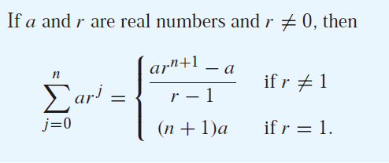
Summations
Summation notation

Slide 13
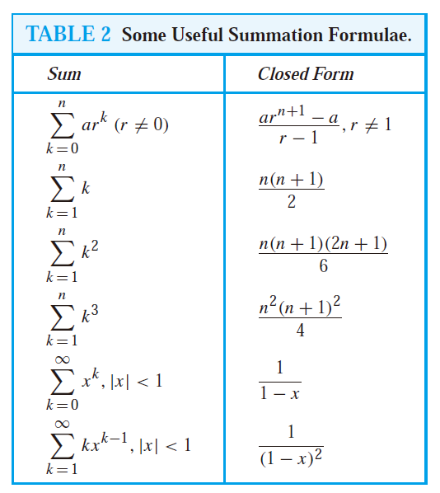

Slide 14
Example

Slide 15
Final Exam
On Jan.2, 2018 (Tuesday)
From 15:00-17:00

