Slide 1
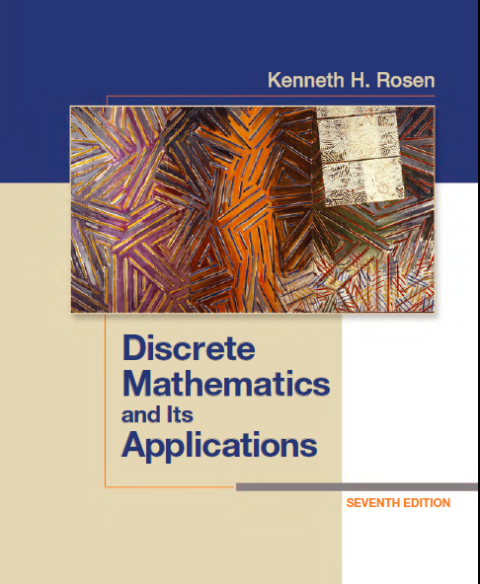
Discrete Math (2)
Haiming Chen
Associate Professor, PhD
Department of Computer Science,
Ningbo University
http://www.chenhaiming.cn

Slide 2
Review
Boolean operators
Boolean identities
Duality principle

Slide 3
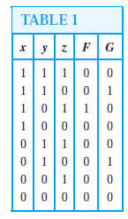
Boolean Expression
Given the values of a Boolean function, how can a Boolean expression that represents this function be found?
What’s F(x,y,z) and G(x,y,z)?

Slide 4
Sum-of-Products Expansions
Any Boolean function can be represented by a Boolean sum of Boolean products of the variables and their complements
minterm

Slide 5
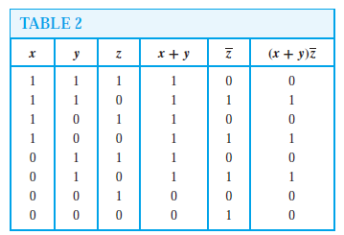
Sum-of-Products Expansions
Another way

Slide 6
Logic Gates
Basic Types of Gates

Slide 7
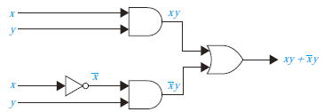
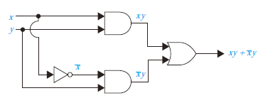
Combinations of Gates

Slide 8
Combinations of Gates

Slide 9
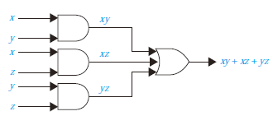
Example
Boolean Function
Boolean Expression
Logic Gates

Slide 10
Homework
Page 822, Exercise 2, 4
Page 828, Exercise 5, 6(d)

