Slide 1
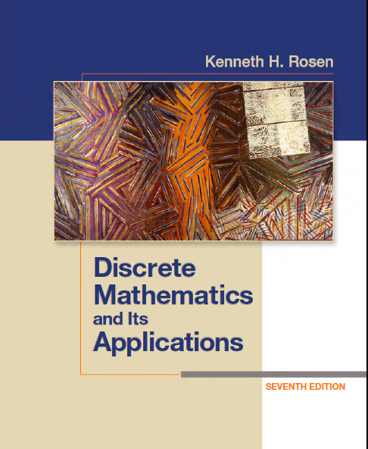
Discrete Math (2)
Haiming Chen
Associate Professor, PhD
Department of Computer Science,
Ningbo University
http://www.chenhaiming.cn

Slide 2
Example
Boolean Function
Boolean Expression
Logic Gates
x | y | z | F
0 | 0 | 0 | 0
0 | 0 | 1 | 0
0 | 1 | 0 | 0
0 | 1 | 1 | 1
1 | 0 | 0 | 0
x | y | z | F
1 | 0 | 1 | 1
1 | 1 | 0 | 1
1 | 1 | 1 | 1

Slide 3
Minimization of Circuits
Produce Boolean sums of Boolean products that represent a Boolean function with the fewest products of literals
To construct a circuit for this function that uses the fewest gates and fewest inputs

Slide 4
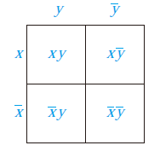
Karnaugh maps
K-maps give us a visual method for simplifying sum-of-products expansions
useful in minimizing circuits with up to six variables
minterm
Adjacent minterms, which differ in exactly one literal.

Slide 5
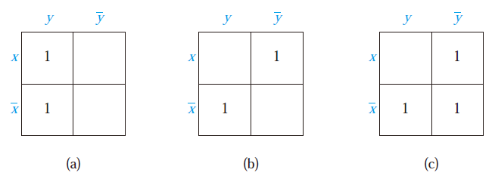
Example
Include a 1 in a cell when the minterm represented by this cell is present in the sum-of-products expansion

Slide 6
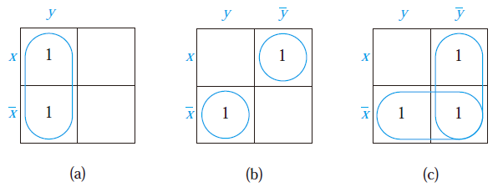
Karnaugh maps
Circle 1s in two adjacent cells in the K-map
adjacent cells can be combined into a product involving just one of the variables

Slide 7
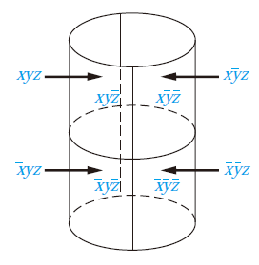
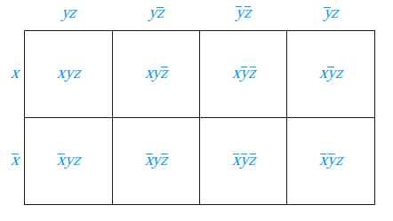
Karnaugh maps
Include a 1 in a cell when the minterm represented by this cell is present in the sum-of-products expansion
1
1
1
1
Circle 1s in two adjacent cells in the K-map

Slide 8
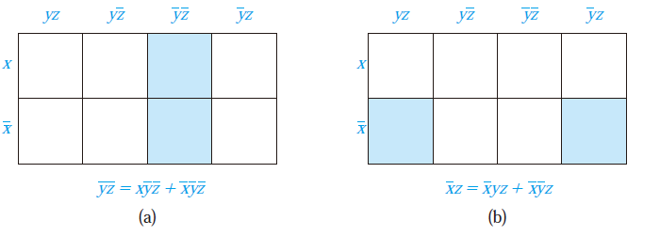
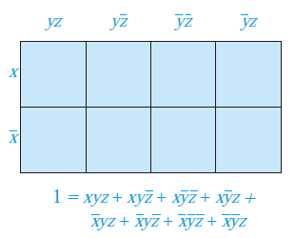
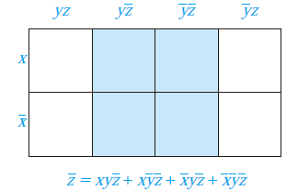
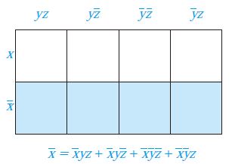
Karnaugh maps

Slide 9
Karnaugh maps
identify the largest possible blocks in the map
cover all the 1s in the map with the least number of blocks
using the largest blocks first

Slide 10
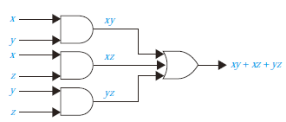
Karnaugh maps
1
1
1
1

Slide 11
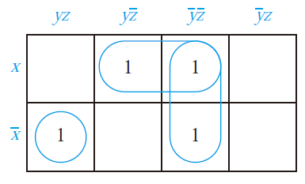
Examples

Slide 12
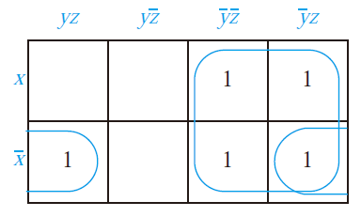
Examples

Slide 13
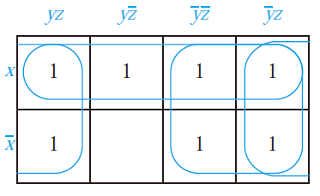
Examples

Slide 14
Examples

Slide 15
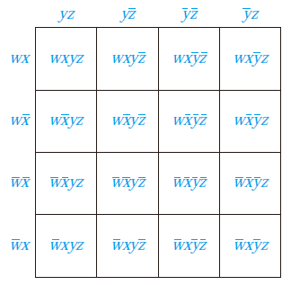
Karnaugh maps
Include a 1 in a cell when the minterm represented by this cell is present in the sum-of-products expansion
Circle 1s in two adjacent cells in the K-map

Slide 16
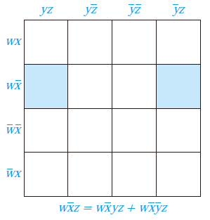
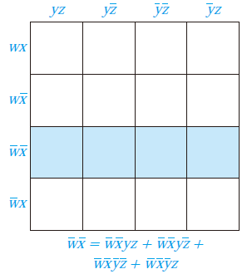
Karnaugh maps

Slide 17
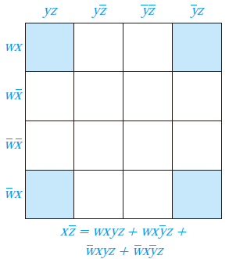
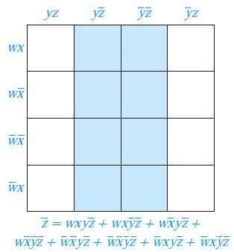
Karnaugh maps

Slide 18
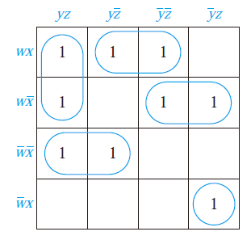
Examples

Slide 19
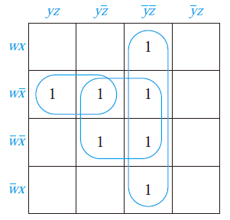
Examples

Slide 20
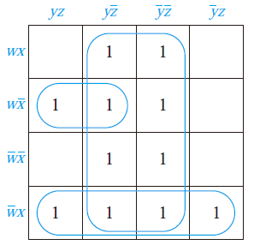
Examples

Slide 21
Homework
Page 842, Exercise 12, 14

