Slide 1
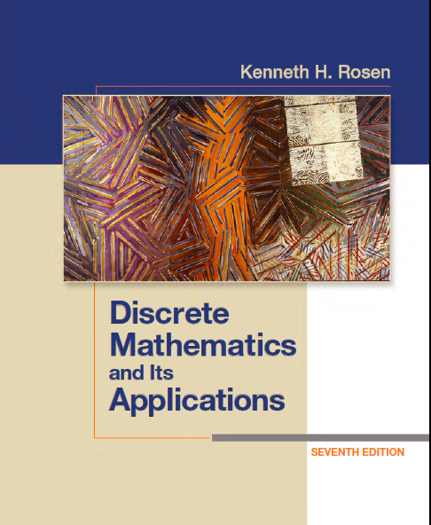
Discrete Math (2)
Haiming Chen
Associate Professor, PhD
Department of Computer Science,
Ningbo University
http://www.chenhaiming.cn

Slide 2
Relations
Relations between elements of sets
represented using the structure called a relation, which is a subset of the Cartesian product of the sets
e.g. A╳B, where A is a set of companies, and B is a set of telephones
A={Intel, Lenovo, ICBC}, B={07548888, 01006666, 0209999}

Slide 3
Relations
If two sets, the relation is represented by a set of ordered pairs
Binary relations
A={Intel, Lenovo, ICBC}, B={07548888, 01006666, 0209999}
{{Intel, 05748888}, {Lenovo, 010006666}, {ICBC, 0209999}}

Slide 4
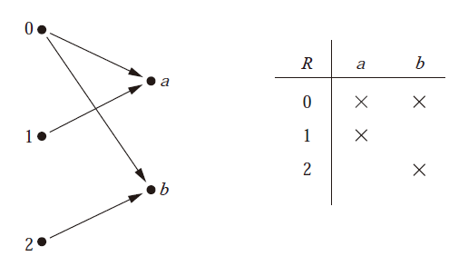
Graphical representation of relationship

Slide 5
Functions as Relations
an element a of A is assigned to the unique element b ∈ B such that (a, b) ∈ R
not a function
one-to-many relationship

Slide 6
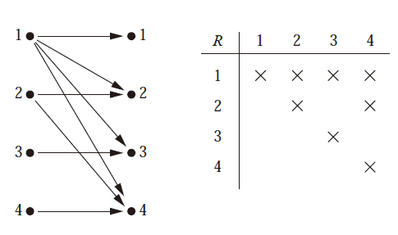
Relations on a set
Let A be the set {1, 2, 3, 4}. Which ordered pairs are in the relation R = {(a, b) | a divides b}?

Slide 7
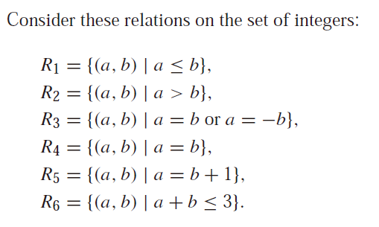
Relations on a set
Which of these relations contain each of the pairs (1, 1), (1, 2), (2, 1), (1,−1), and (2, 2)?

Slide 8
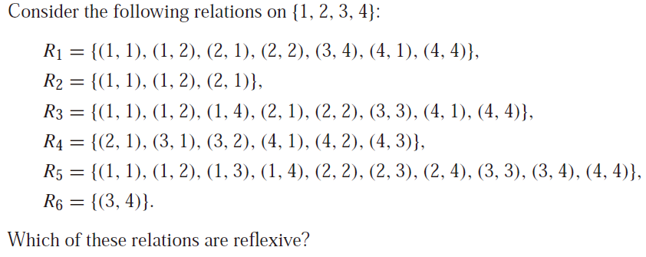
Properties of Relations
The relation R on the set A is reflexive if ∀a((a, a) ∈ R)

Slide 9
The relation R on the set A is reflexive if ∀a((a, a) ∈ R)

Slide 10
Properties of Relations
the relation R on the set A is symmetric if ∀a∀b((a, b) ∈ R → (b, a) ∈ R).
if and only if a is related to b implies that b is related to a.
the relation R on the set A is antisymmetric if ∀a∀b(((a, b) ∈ R ∧ (b, a) ∈ R) → (a = b)).
if and only if there are no pairs of distinct elements a and b with a related to b and b related to a
a relation can lack both of these two properties
symmetric
symmetric
antisymmetric
antisymmetric
antisymmetric

Slide 11
Properties of Relations
antisymmetric
antisymmetric
symmetric
symmetric
antisymmetric
antisymmetric
symmetric
a relation can have both of these two properties
symmetric and antisymmetric are not opposites

Slide 12
Properties of Relations
Using quantifiers we see that the relation R on a set A is transitive if we have
∀a∀b∀c(((a, b) ∈ R ∧ (b, c) ∈ R) → (a, c) ∈ R).
transitive
transitive
transitive

Slide 13
Properties of Relations
transitive
transitive
transitive
transitive

Slide 14
Combining Relations
Let A = {1, 2, 3} and B = {1, 2, 3, 4}. The relations R1 = {(1, 1), (2, 2), (3, 3)} and R2 = {(1, 1), (1, 2), (1, 3), (1, 4)} can be combined to obtain
={(1,2), (1,3), (1,4),(2,2),(3,3)}

Slide 15
Combining Relations

Slide 16
Combining Relations
Let R be a relation from a set A to a set B and S a relation from B to a set C. The composite of R and S is the relation consisting of ordered pairs (a, c), where a ∈ A, c ∈ C, and for which there exists an element b ∈ B such that (a, b) ∈ R and (b, c) ∈ S. We denote the composite of R and S by S ◦R.

Slide 17
Combining Relations

Slide 18
Homework
Page 581, Ex.3, 6, 30, 56

