Slide 1
Discrete Math (2)
Haiming Chen
Associate Professor, PhD
Department of Computer Science,
Ningbo University
http://www.chenhaiming.cn

Slide 2
n-ary Relations and Their Applications
airline flight number {CA101, CZ203}
starting point {BJ, SH, NB}
destination {HZ, GZ, SZ}
departure time {8:00, 12:00}
arrival time {10:00, 15:00}

Slide 3
Examples
N × N × N consisting of triples (a, b, c), where a, b, and c are integers with a < b < c
Z × Z × Z consisting of all triples of integers (a, b, c), if and only if there is an integer k such that b = a + k and c = a + 2k
Z × Z × Z⁺ , consisting of triples (a, b, m), where a, b, and m are integers with m ≥ 1 and a ≡ b (mod m)
(A, N, S, D, T ) representing airplane flights, where A is the airline, N is the flight number, S is the starting point, D is the destination, and T is the departure time.

Slide 4
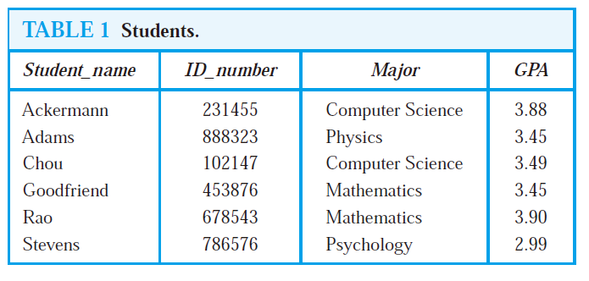
Databases and Relations
the value of the n-tuple from
this domain determines the n-tuple
relational data model
primary key
Field/ attribute
record
(Stevens, 786576, Psychology, 2.99) n-tuples
composite key

Slide 5
Operations on n-ary Relations
form new n-ary relations

Slide 6
Operations on n-ary Relations
Selection operator
answer queries on databases that ask for all n-tuples that satisfy certain conditions
find the records of all computer science majors who have a grade point average above 3.5.

Slide 7
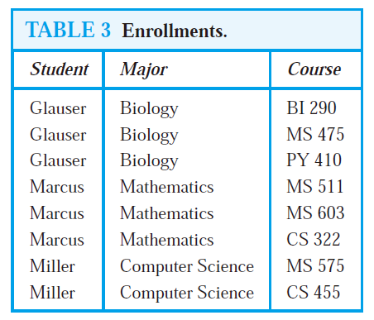
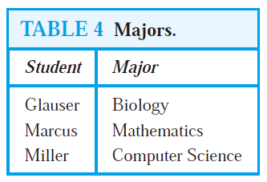
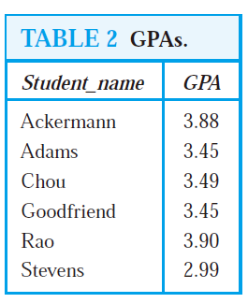
Operations on n-ary Relations
Projection
maps the n-tuple (a₁, a₂, . . . , a_{n}) to the m-tuple (a_{i1} , a_{i2}, . . . , a_{im}), where m ≤ n.
P_{1,4}
P_{1,2}

Slide 8
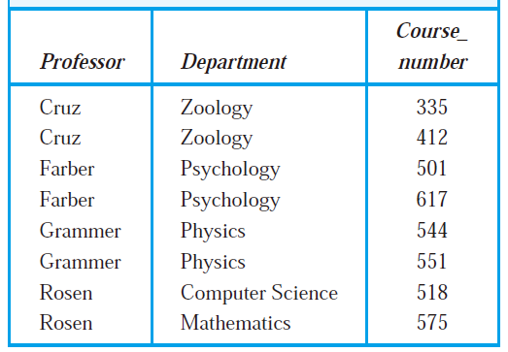
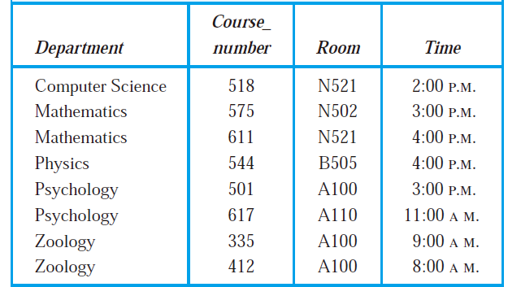
Operations on n-ary Relations
Join
produces a new relation from two relations by combining all m-tuples of the first relation with all n-tuples of the second relation, where the last p components of the m-tuples agree with the first p components of the n-tuples
J₂

Slide 9
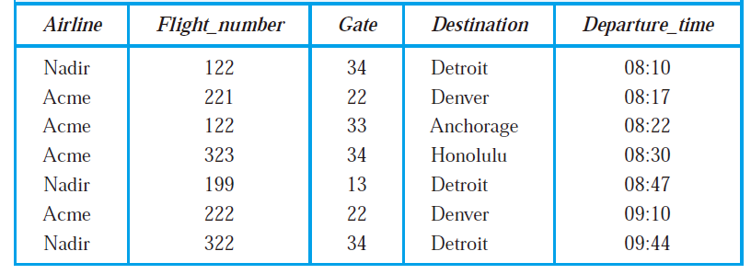
SQL
Structured Query Language

Slide 10
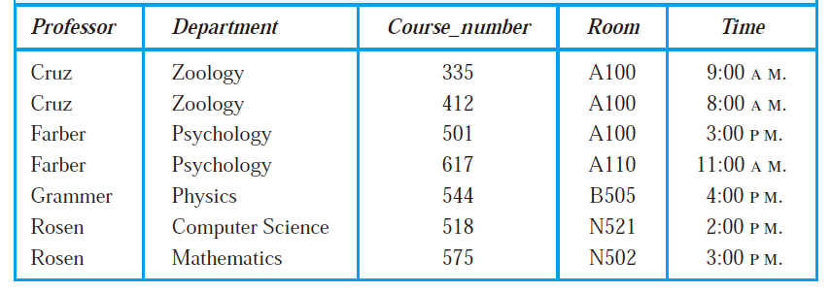
SQL
P_{1,5}
J₂

Slide 11
Homework
Page 590, Ex.28, 29

