Slide 1
Discrete Math (2)
Haiming Chen
Associate Professor, PhD
Department of Computer Science,
Ningbo University
http://www.chenhaiming.cn

Slide 2
Content
Equivalence Relations
Equivalence Classes
Partitions

Slide 3
Equivalence Relations
A relation R on a set A is called an equivalence relation if it is reflexive, symmetric, and transitive.
if (a,b)∈R or a R b, a and b are equivalent, denoted as a ∽ b
Every element should be equivalent to itself

Slide 4
Example 1
Let R be the relation on the set of integers such that aRb if and only if a = b or a = −b.
Equivalence relation or not?
Reflexive?
Symmetric?
Transitive?

Slide 5
Example 2
Let R be the relation on the set of real numbers such that aRb if and only if a − b is an integer.
Is R an equivalence relation?
Reflexive? a −a = 0 is an integer
Symmetric? a −b is an integer, so b−a is also an integer
Transitive? a −b and b−c are integers, so a −c = (a −b) + (b−c) is also an integer

Slide 6
Example 3
Let m be an integer with m > 1. R = {(a, b) | a ≡ b (mod m)}
on the set of integers
Reflexive? a ≡ a (mod m)
Symmetric? a − b = km, b − a = (−k)m, so b ≡ a (mod m)
Transitive? a − b = km and b − c = lm, a − c = (a − b) + (b − c) = km + lm = (k + l)m
Congruence Modulo m

Slide 7
Example 4
Suppose that R is the relation on the set of strings of English letters such that aRb if and only if l(a) = l(b), where l(x) is the length of the string x.
Is R an equivalence relation?

Slide 8
Example 5
Let n be a positive integer and S a set of strings. Suppose that R_{n} is the relation on S such that sR_{n}t if and only if s = t , or both s and t have at least n characters and the first n characters of s and t are the same.
Reflexive?
Symmetric?
Transitive?
In traditional C, only the first eight characters of a variable name are checked by the compiler

Slide 9
Example 6
the “divides” relation on the set of positive integers an equivalence relation.
Let R be the relation on the set of real numbers such that xRy if and only if x and y are real numbers that differ by less than 1, that is |x − y| < 1.
is not
R is not an equivalence relation.

Slide 10
Content
Equivalence Relations
Equivalence Classes
Partitions

Slide 11
Equivalence Classes
The set of all elements that are related to an element a of A is called the equivalence class of a.
The equivalence class of a with respect to R is denoted by [a]_{R}.
When only one relation is under consideration, we can write [a] for this equivalence class.
If b ∈ [a]_{R}, then b is called a representative of this equivalence class.

Slide 12
Example
Let R be the relation on the set of integers such that aRb if and only if a = b or a = −b.
[7] = {−7, 7}, [−5] = {−5, 5}, and [0] = {0}.

Slide 13
Example
Let m be an integer with m > 1. R = {(a, b) | a ≡ b (mod m)}, m=4
[0] = {. . . ,−8,−4, 0, 4, 8, . . . }.
[1] = {. . . ,−7,−3, 1, 5, 9, . . . }.
[a]_{m} = {. . . , a − 2m, a − m, a, a + m, a + 2m, . . .}.

Slide 14
Example
Let n be a positive integer and S a set of strings. Suppose that R_{n} is the relation on S such that sR_{n}t if and only if s = t , or both s and t have at least n characters and the first n characters of s and t are the same.
n=3
[011]_{R3}= {011, 0110, 0111, 01100, 01101, 01110, 01111, . . .}.

Slide 15
Content
Equivalence Relations
Equivalence Classes
Partitions

Slide 16
Partitions
Let A be the set of students at your school who are majoring in exactly one subject, and let R be the relation on A consisting of pairs (x, y), where x and y are students with the same major.
[student₁]_{Rcs}={student₁, student₂, …student_{m}}
[student_{m+1}]_{Ree}={student_{m+1}, student_{m+2}, …student_{n+m}}
[a] ≠ [b] [a] ∩ [b] = O

Slide 17
Partitions
The union of the equivalence classes of R is all of A
A= [student₁]_{Rcs} ∪[studentm+1] _{Ree}
Z= [0] _{m} ∪ [1] _{m} ∪ [2] _{m} ∪…… ∪ [m-1]_{m}
a partition of a set S is a collection of disjoint nonempty subsets of S that have S as their union.
equivalence classes form a partition of A
an equivalence relation partitions a set

Slide 18
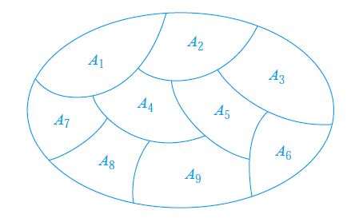
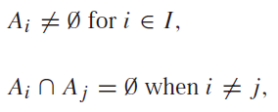
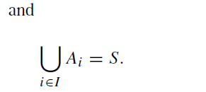
Partitions
Conversely, every partition of a set can be used to form an equivalence relation.

Slide 19
Example 1
a partition A₁ = {1, 2, 3}, A₂ = {4, 5}, and A₃ = {6} of S = {1, 2, 3, 4, 5, 6}
What’s the equivalence relation R?
(1, 1), (1, 2), (1, 3), (2, 1), (2, 2), (2, 3), (3, 1), (3, 2), and (3, 3)
(4, 4), (4, 5), (5, 4), and (5, 5)
(6, 6)

Slide 20
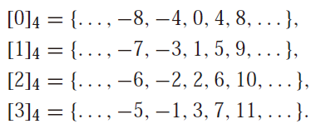
Example 2
What are the sets in the partition of the integers arising from congruence modulo 4?

Slide 21
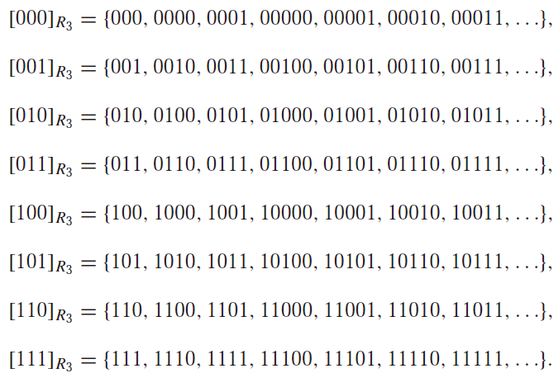
Example 3
What are the sets in the partition of the set of all bit strings arising from the relation R₃ on the set of all bit strings?

Slide 22
Homework
Page 615, Ex.1, 47

